Slide 1

D3.js Tutorial (Hands on Session)
Ayush Kumar and Klaus Mueller

Slide 2

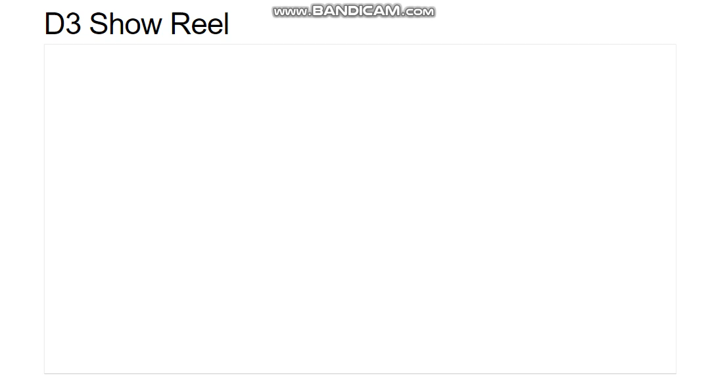
D3: Data-Driven Documents
AAPL
AMZN
IBM
MSFT
https://bl.ocks.org/mbostock/1256572
Notes:
Lines --- horizons ---- areas ---- stacked areas ---- streamgraph ---- overlapping areas ----- grouped bars ---- stacked bars ----- bars ----- donut

Slide 3
D3: Data-Driven Documents
D3.js is a JavaScript library for manipulating documents based on data
Data
Driven
Transformation
Notes:
Lines --- horizons ---- areas ---- stacked areas ---- streamgraph ---- overlapping areas ----- grouped bars ---- stacked bars ----- bars ----- donut

Slide 4
D3: Technology & Concept
D3 Library
JQuery (Bonus)
Data Visualization
JSON/CSV
Array & Objects
SVG – Scalable Vector Graphics
Transitions
Data Scaling
Data Binding
Data Display & Charting
Notes:
Lines --- horizons ---- areas ---- stacked areas ---- streamgraph ---- overlapping areas ----- grouped bars ---- stacked bars ----- bars ----- donut

Slide 5
Directory Structure
Replace “CSE564” with your “Project_Folder” name
CSE564/
index.html
CSE564 /lib/
d3.v4.js
CSE564 /js/
test.js
CSE564 /css/
style.css
CSE564 /data/
iris.csv
http://www3.cs.stonybrook.edu/~aykumar/CSE564.zip

Slide 6
VERY VERY IMPORTANT !!!
Please do not be hesitant to ask questions!

Slide 7
SVG Basics
(0,0)
y
SVG is an XML language, similar to XHTML, which can be used to draw vector graphics.
It can be used to create an image either by specifying all the lines and shapes necessary, by modifying already existing raster images, or by a combination of both.
x
Notes:
Lines --- horizons ---- areas ---- stacked areas ---- streamgraph ---- overlapping areas ----- grouped bars ---- stacked bars ----- bars ----- donut

Slide 8
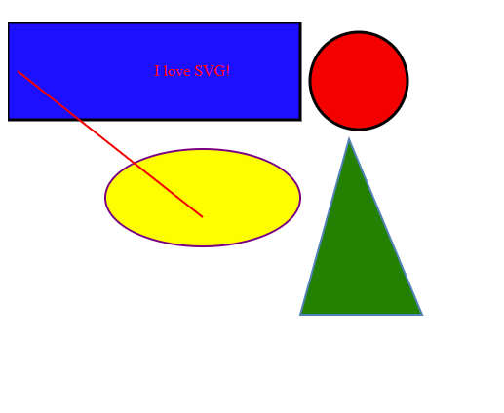
SVG Shapes
<rect>
<svg width="400" height="110"> <rect width="300" height="100" style="fill:rgb(0,0,255);stroke-width:3;stroke:rgb(0,0,0)" /> </svg>
<circle>
<svg height="100" width="100"> <circle cx="50" cy="50" r="40" stroke="black" stroke-width="3" fill="red" /> </svg>
<ellipse>
<svg height="140" width="500"> <ellipse cx="200" cy="80" rx="100" ry="50" style="fill:yellow;stroke:purple;stroke-width:2" /> </svg>
<line>
<svg height="210" width="500"> <line x1="0" y1="0" x2="200" y2="200" style="stroke:rgb(255,0,0);stroke-width:2" /> </svg>
<text>
<svg height="30" width="200"> <text x="0" y="15" fill="red">I love SVG!</text> </svg>
<path>
<svg height=“500" width=“500">
<path d="M350 120 L300 300 L425 300 Z" style="fill:green;stroke:steelblue;stroke-width:2" />
</svg>
https://developer.mozilla.org/en-US/docs/Web/SVG/Tutorial/Basic_Shapes
Notes:
<svg width="200" height="200" viewBox="0 0 100 100">
he whole SVG canvas here is 200px by 200px in size. However, the viewBoxattribute defines the portion of that canvas to display. These 200x200 pixels display an area that starts at user unit (0,0) and spans 100x100 user units to the right and to the bottom.

Slide 9
AND NOW D3 …
DOM SELECTION & MANIPULATION
LOADING DATA
ENTER-UPDATE-EXIT PARADIGM (DATA BINDING)
CHARTS
SCALES
AXES
TRANSITIONS AND INTERACTION
How to make this Work ???

Slide 10
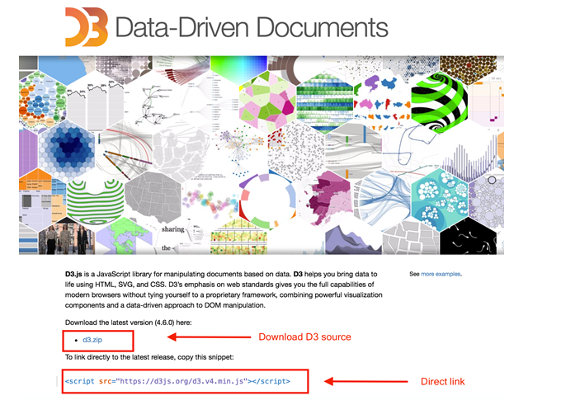
D3 Begins…
Setup D3.js Development Environment
D3 library
Web server
Editor
Web browser

Slide 11
D3 Begins…
Setup D3.js Development Environment
D3 library
Web server
Editor
Web browser
<script src="../d3.js"></script>
<script src="../d3.min.js"></script>
<script src="https://d3js.org/d3.v4.min.js"></script>
Notes:
This defines a global JavaScript object d3, which includes all the important methods to start with, just like jQuery includes a global object called jQuery (or $).

Slide 12
D3 Begins…
Setup D3.js Development Environment
D3 library
Web server
Editor
Web browser
python -m SimpleHTTPServer 8000
http://localhost:8000/

Slide 13




D3 Begins…
Setup D3.js Development Environment
D3 library
Web server
Editor
Web browser
Notes:
Ctrl+Alt+Q (Stop the Server)
Ctrl+Alt+L (Start the Server) and direct the page to index.html
WebStorm

Slide 14
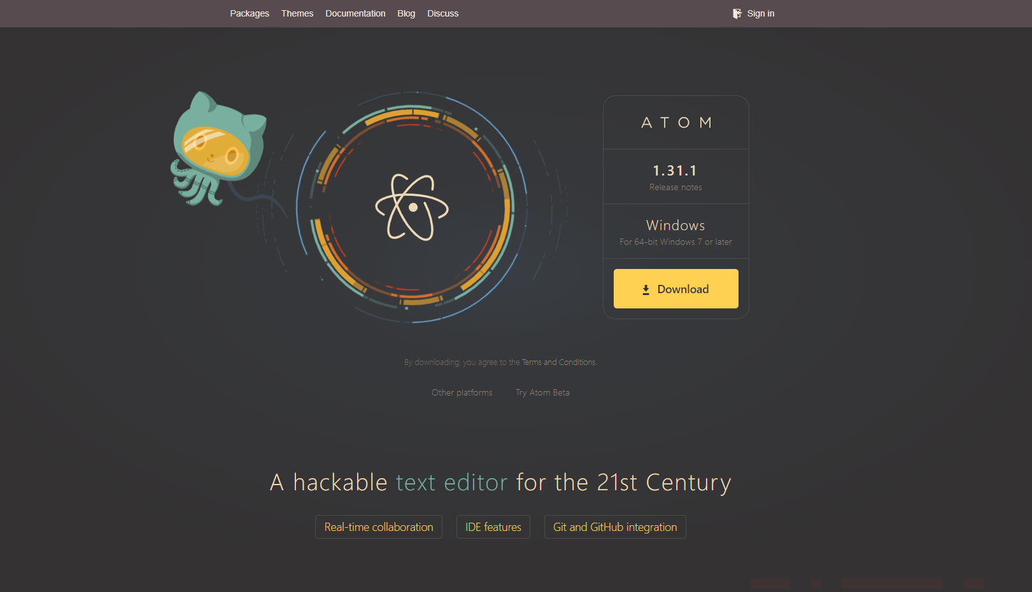
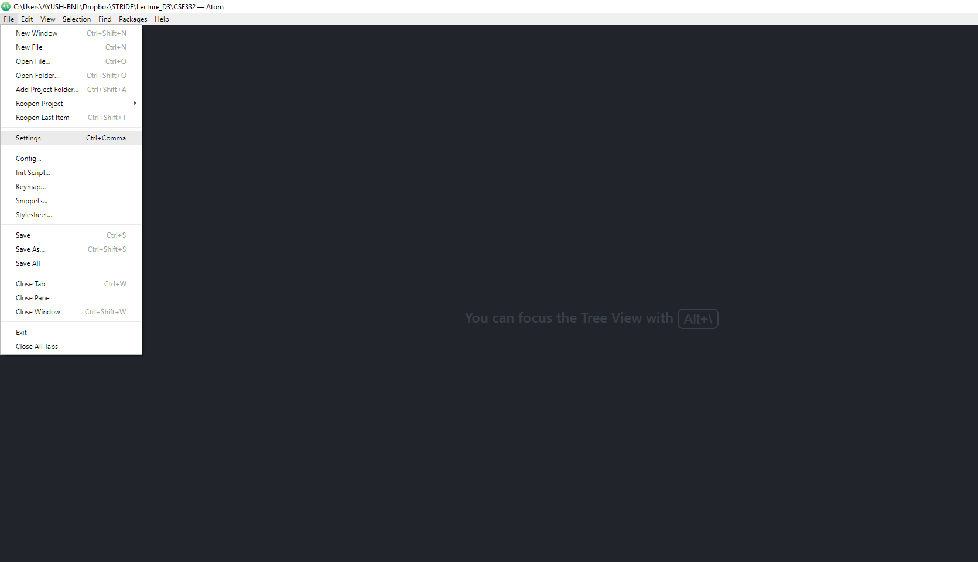
Editor Set Up
Open Editor and Navigate to Settings
Download & Install Atom
Notes:
Ctrl+Alt+Q (Stop the Server)
Ctrl+Alt+L (Start the Server) and direct the page to index.html
WebStorm

Slide 15
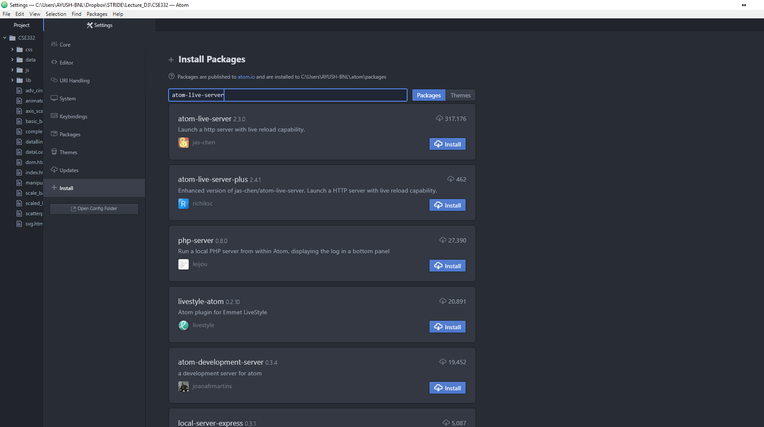
Editor Set Up
Done with Installation, Now Use below Keys in Editor to Launch the Server
Search for atom-live-server
2
ctrl-alt-l launch live server on port 3000.
ctrl-alt-q stop live server.
ctrl-alt-3 launch live server on port 3000.
ctrl-alt-4 launch live server on port 4000.
ctrl-alt-5 launch live server on port 5000.
ctrl-alt-8 launch live server on port 8000.
ctrl-alt-9 launch live server on port 9000.
4
Open Setting
Click Install
1
3
Download Atom
Navigate to Install Option
Notes:
Ctrl+Alt+Q (Stop the Server)
Ctrl+Alt+L (Start the Server) and direct the page to index.html

Slide 16



D3 Begins…
Setup D3.js Development Environment
D3 library
Web server
Editor
Web browser
Notes:
Ctrl+Alt+Q (Stop the Server)
Ctrl+Alt+L (Start the Server) and direct the page to index.html

Slide 17
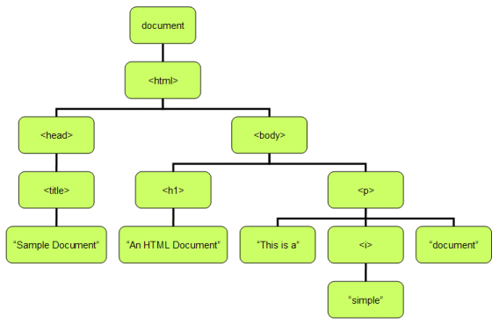
D3 DOM
DOM SELECTION & MANIPULATION
LOADING DATA
ENTER-UPDATE-EXIT PARADIGM (DATA BINDING)
CHARTS
SCALES
AXES
TRANSITIONS AND INTERACTION
https://www.cs.pu.edu.tw/~tsay/course/webprog/notes/DOM
Notes:
The Document Object Model (DOM) is a cross-platform and language-independent application programming interface that treats an HTML, XHTML, or XML document as a tree structure where in each node is an object representing a part of the document

Slide 18
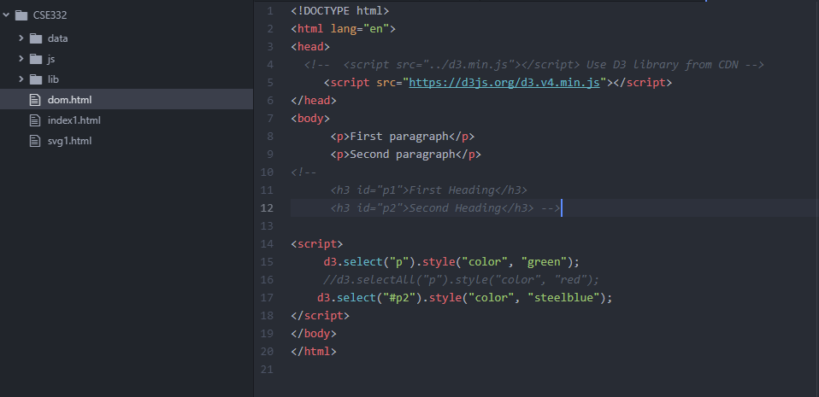
DOM Selection
d3.select()
Select Element By Tag Name
Select Element By Id
d3.selectAll()
Select Element By Tag Name
Select Element By Id
Select Element By CSS Class Name
Notes:
The following example demonstrates selecting the first matching element by tag name using d3.select.
d3.select("p") returns first <p> element and then, .style("color","green")
d3.select() method can also be used to get an element with specified id

Slide 19
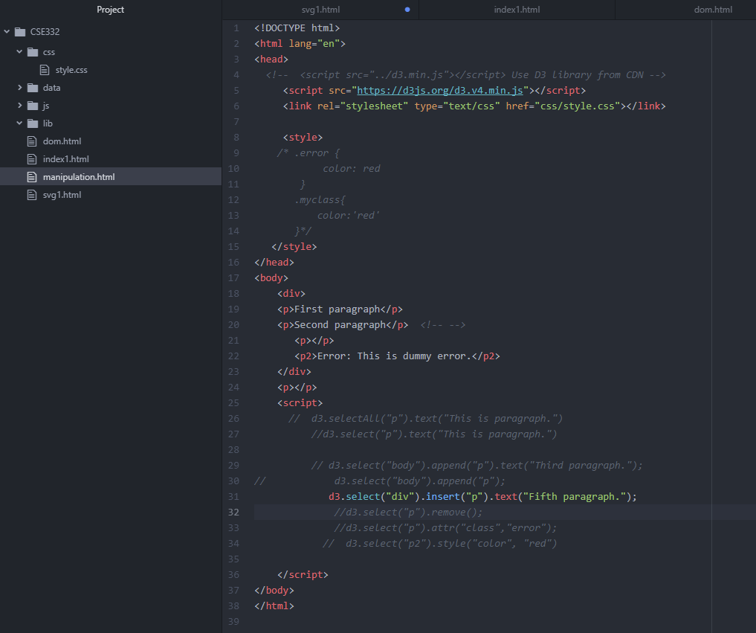
DOM Manipulation
text()
append()
insert()
remove()
html()
attr()
property()
style()
Notes:
Use d3.selection.append() method to create a new DOM element and add it at the end of selected DOM element.
d3.select("body") returns the body element and .append("p") creates a new <p> element and adds it just before the end of the <body>.
I think the reason for choosing insert() over append() is rather a matter of handling mouse events. Insert is associated at index where to put the selected element.
d3.select("p") selects the <p> element and .attr("class","error") applies class attribute to the paragraph element.

Slide 20
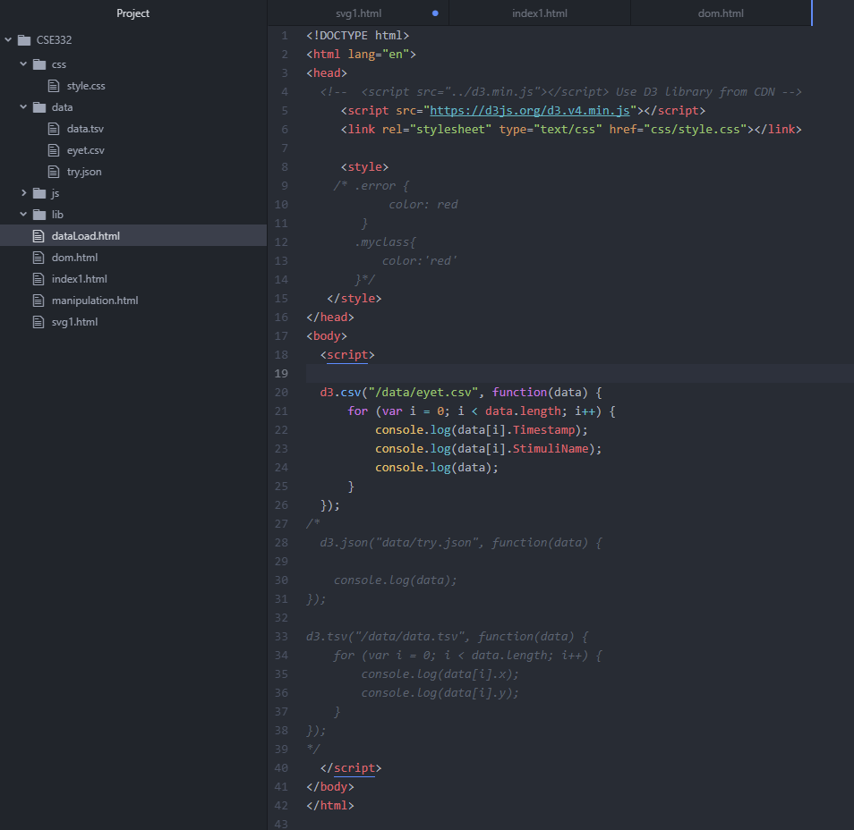
D3 Data Loading
DOM SELECTION & MANIPULATION
LOADING DATA
ENTER-UPDATE-EXIT PARADIGM (DATA BINDING)
CHARTS
SCALES
AXES
TRANSITIONS AND INTERACTION

Slide 21
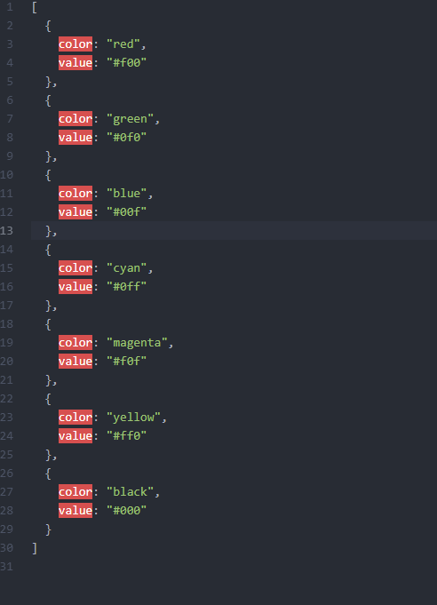
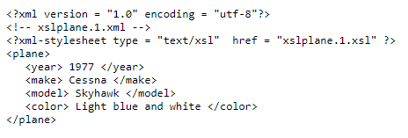
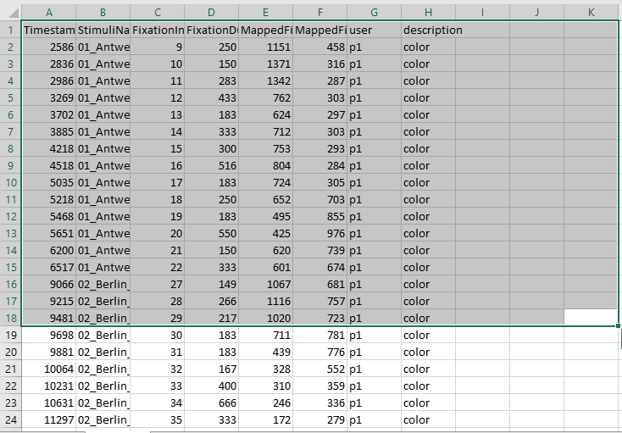
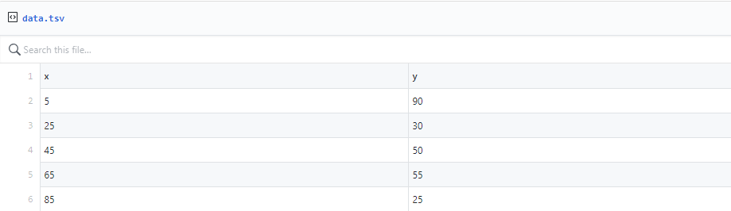
D3 Data Loading
d3.csv()
d3.json()
d3.tsv()
d3.xml()

Slide 22
D3 DOM
DOM SELECTION & MANIPULATION
LOADING DATA
ENTER-UPDATE-EXIT PARADIGM (DATA BINDING)
CHARTS
SCALES
AXES
TRANSITIONS AND INTERACTION
Notes:
The Document Object Model (DOM) is a cross-platform and language-independent application programming interface that treats an HTML, XHTML, or XML document as a tree structure where in each node is an object representing a part of the document

Slide 23
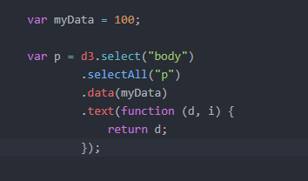
D3 Data Binding
data()
enter()
exit()
datum()
Notes:
The data() function is used to join the specified array of data to the selected DOM elements and return the updated selection
demonstrates how to join data as an array into your existing DOM element using data() function.
Remember, you need to pass an array to the data() function. It a constant value.
.text(function(d, i) { return d; }); this text function adds the data as tdoes not do anything if you provide ext to each of our selection element. Each array value is passed as the first argument (d) to text function. In this case, an existing text from paragraph element, 'D3 tutorial', will get replaced with the first array value 'Hello World'.

Slide 24
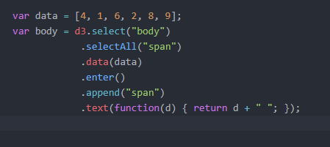
D3 Data Binding
data()
enter()
exit()
datum()
Notes:
The enter() method dynamically creates placeholder references corresponding to the number of data values. The output of enter() can be fed to append() method and append() will create DOM elements for which there are no corresponding DOM elements on the page.
At this point, there are no span elements in the body. So this will return an empty array.
The enter() function checks for <span> elements corresponding to our five array elements. Since it does not find any, it will create a span for each of the five elements.
By applying the data() operator to our selection, we join data items and DOM elements with each other:

Slide 25
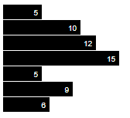
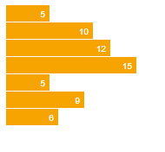
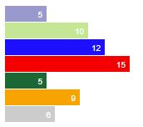

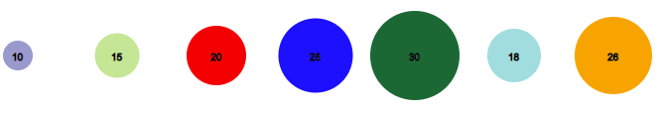
D3 CHARTS
DOM SELECTION & MANIPULATION
LOADING DATA
ENTER-UPDATE-EXIT PARADIGM (DATA BINDING)
CHARTS
SCALES
AXES
TRANSITIONS AND INTERACTION

Slide 26
D3 SCALING
DOM SELECTION & MANIPULATION
LOADING DATA
ENTER-UPDATE-EXIT PARADIGM (DATA BINDING)
CHARTS
SCALES
AXES
TRANSITIONS AND INTERACTION

Slide 27
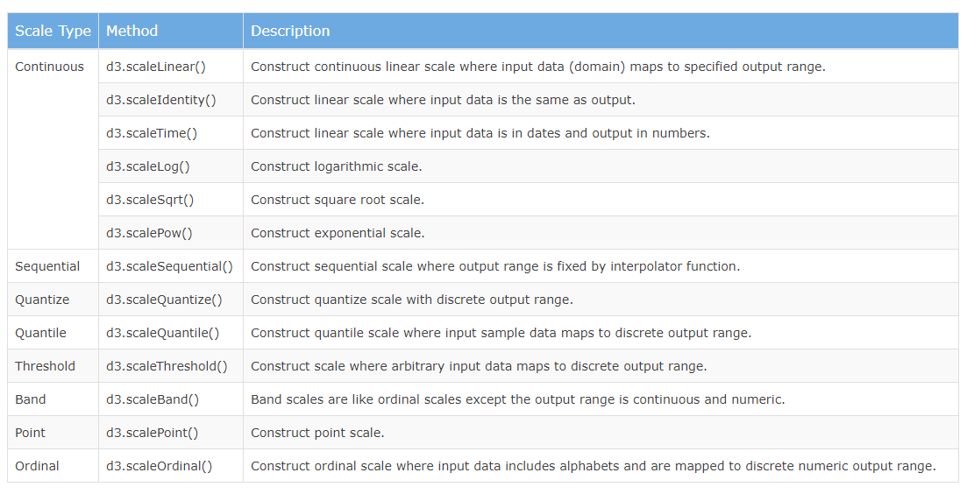
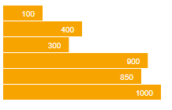
D3 SCALING

Slide 28
D3 Axis
DOM SELECTION & MANIPULATION
LOADING DATA
ENTER-UPDATE-EXIT PARADIGM (DATA BINDING)
CHARTS
SCALES
AXES
TRANSITIONS AND INTERACTION

Slide 29
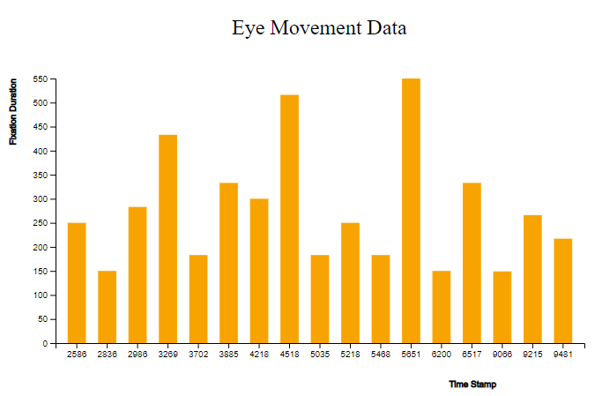
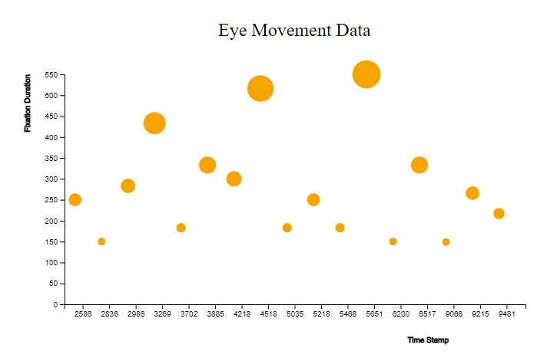
D3 Axis (Exactly Same Data)

Slide 30
D3 Animation
DOM SELECTION & MANIPULATION
LOADING DATA
ENTER-UPDATE-EXIT PARADIGM (DATA BINDING)
CHARTS
SCALES
AXES
TRANSITIONS AND INTERACTION

Slide 31
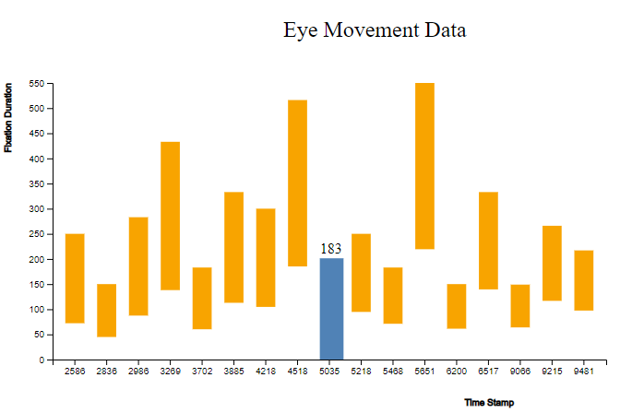
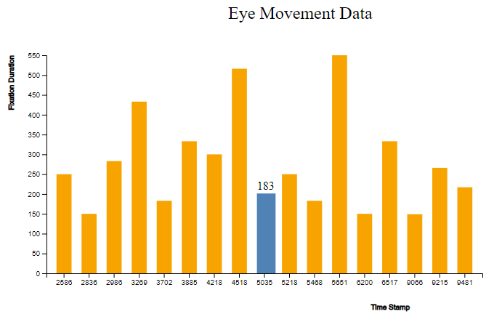
D3 Animation

Slide 32
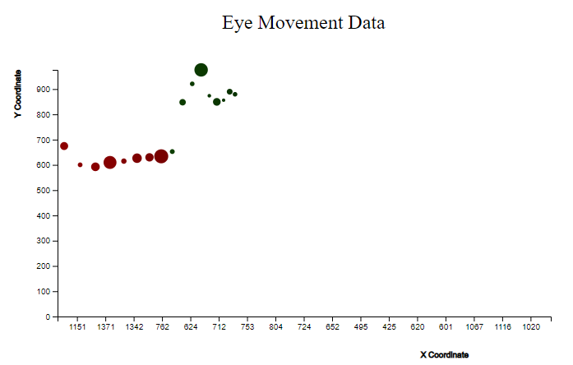
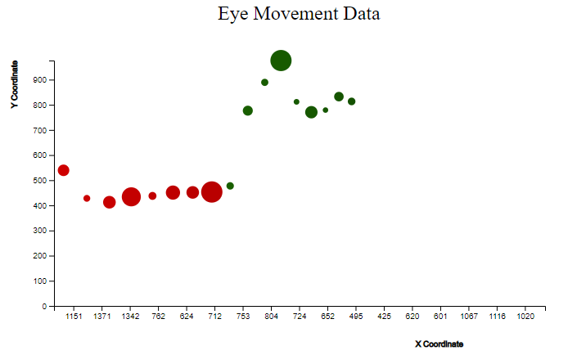
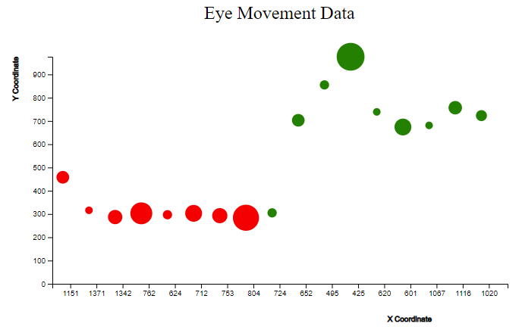
D3 Animation

Slide 33
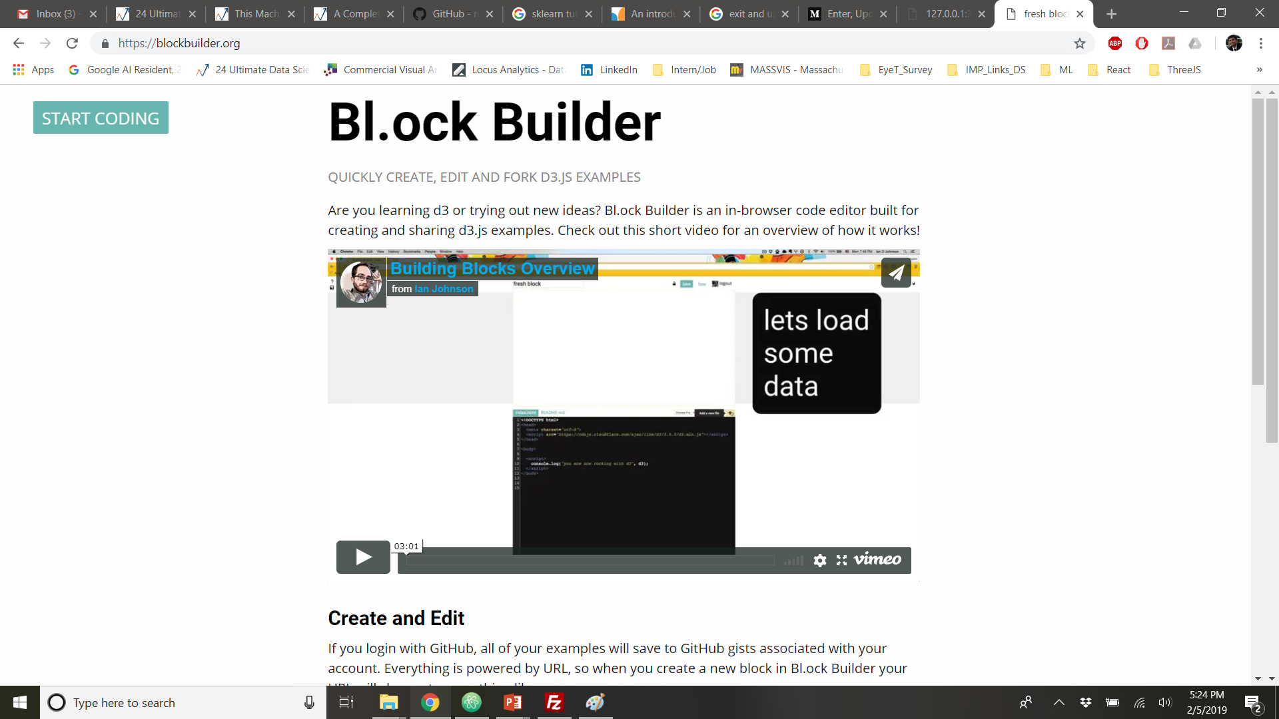
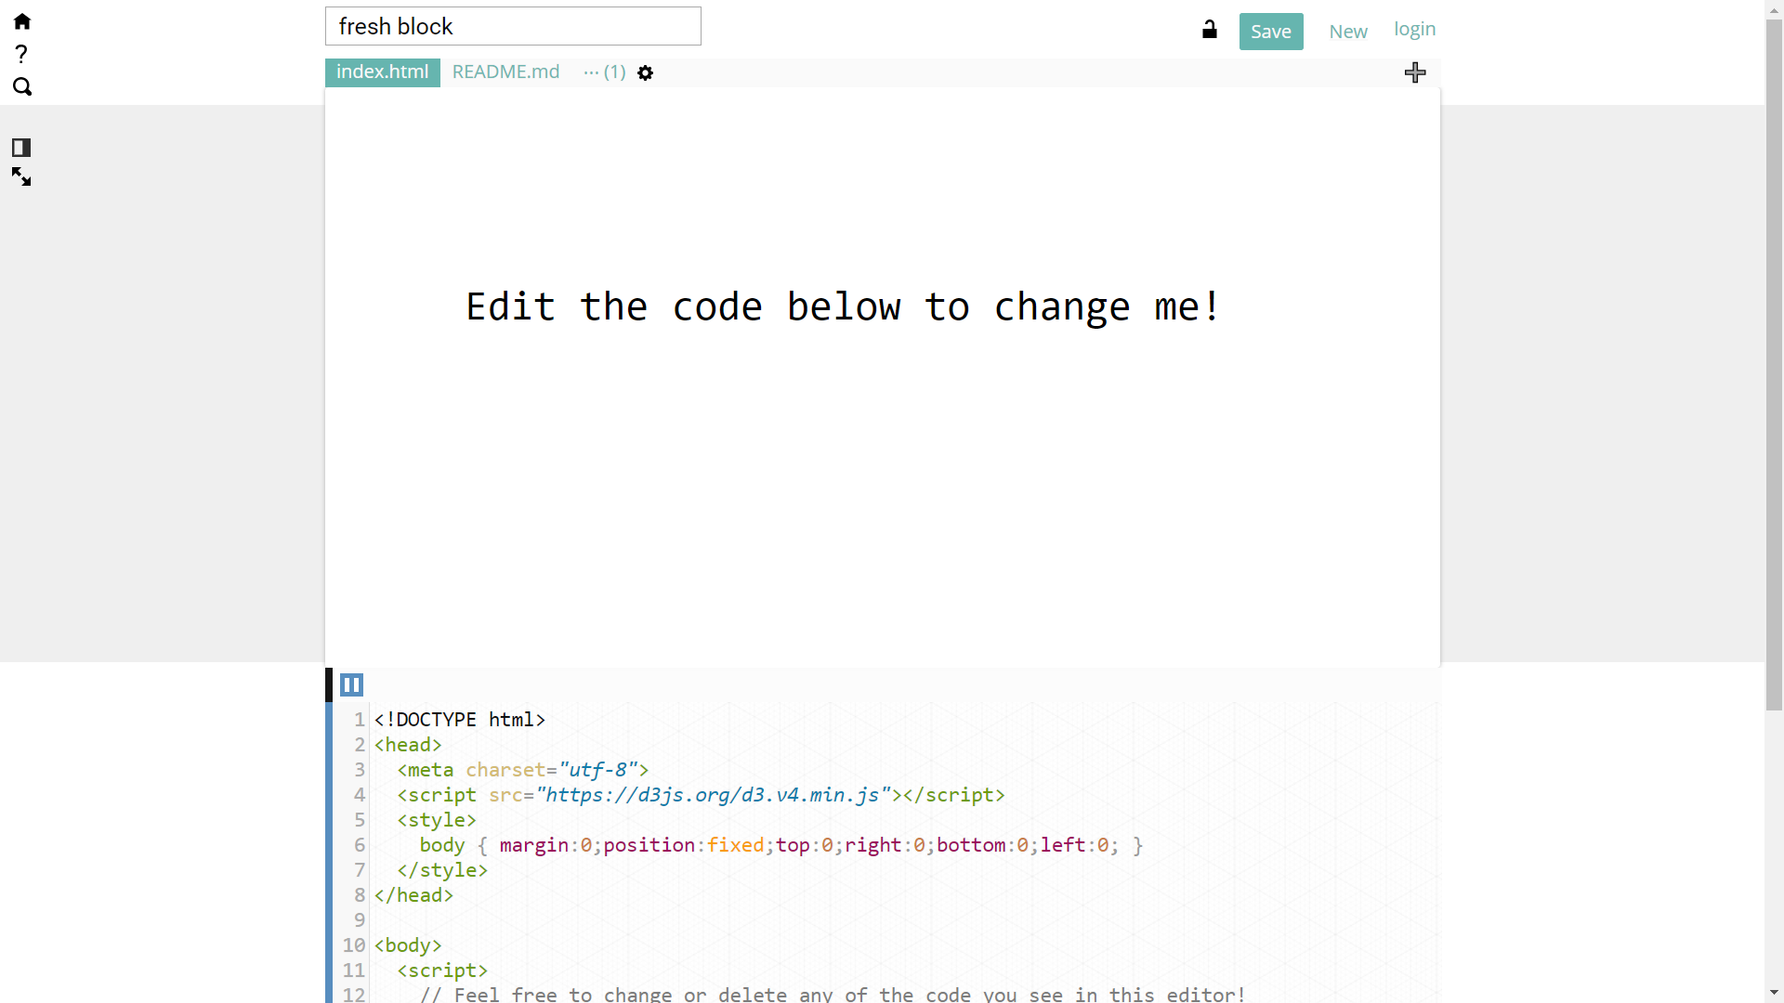
Bl.ock Builder
https://blockbuilder.org/

Slide 34
References
https://www.dashingd3js.com/d3-v4-tutorial
https://github.com/d3/d3/wiki/Gallery
http://poloclub.gatech.edu/cse6242/2014spring/lectures/CSE6242-20140123-Stolper-D3.pdf
https://bost.ocks.org/mike/d3/workshop/#0
http://www.tutorialsteacher.com/d3js
https://square.github.io/intro-to-d3/
http://alignedleft.com/tutorials
https://www.tutorialspoint.com/d3js/

